Slide 1
Deep Learning (MNIST)
Wonseok Jung

Slide 2
Introduction

Slide 3
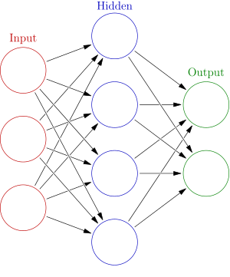

DeepLearning-1
Neural Network.
Weight
Bias

Slide 4

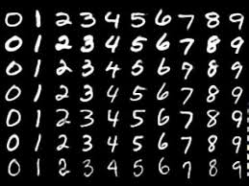
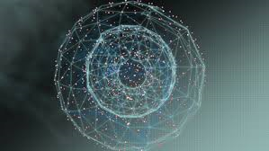
2.Deep learning and Machine learning-1
Machine Learning.

Slide 5
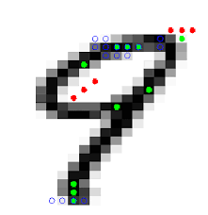
2.Deep learning and Machine learning-2
Feature.
Vector
SVM
KNN

Slide 6
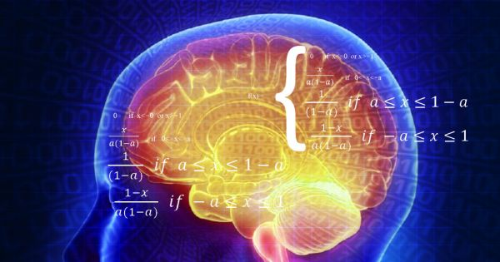
2. Deep learning and Machine learning-3
Output

